Slide 1
Generalized Linear Models
CS771: Introduction to Machine Learning
Purushottam Kar

Slide 2
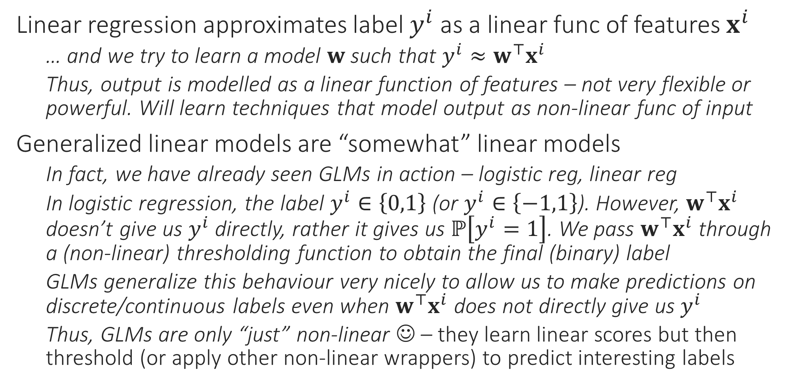
Generalized Linear Models (GLM/GLiM)
Linear regression approximates label $y^{i}$ as a linear func of features $x^{i}$
… and we try to learn a model $w$ such that $y^{i}≈w^{⊤}x^{i}$
Thus, output is modelled as a linear function of features – not very flexible or powerful. Will learn techniques that model output as non-linear func of input
Generalized linear models are “somewhat” linear models
In fact, we have already seen GLMs in action – logistic reg, linear reg
In logistic regression, the label $y^{i}∈\left\{0,1\right\}$ (or $y^{i}∈\left\{−1,1\right\}$). However, $w^{⊤}x^{i}$ doesn’t give us $y^{i}$ directly, rather it gives us $ℙ\left[y^{i}=1\right]$. We pass $w^{⊤}x^{i}$ through a (non-linear) thresholding function to obtain the final (binary) label
GLMs generalize this behaviour very nicely to allow us to make predictions on discrete/continuous labels even when $w^{⊤}x^{i}$ does not directly give us $y^{i}$
Thus, GLMs are only “just” non-linear ☺ – they learn linear scores but then threshold (or apply other non-linear wrappers) to predict interesting labels

Slide 3
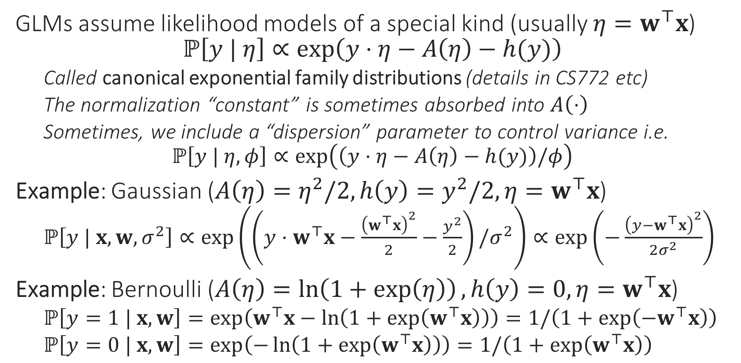
Generalized Linear Models
GLMs assume likelihood models of a special kind (usually $η=w^{⊤}x$) $ℙ\left[y | η\right]∝\exp\left(y⋅η−A\left(η\right)−h(y)\right)$
Called canonical exponential family distributions (details in CS772 etc)
The normalization “constant” is sometimes absorbed into $A\left(⋅\right)$
Sometimes, we include a “dispersion” parameter to control variance i.e. $ℙ\left[y | η,φ\right]∝\exp\left(\left(y⋅η−A\left(η\right)−h(y)\right)/φ\right)$
Example: Gaussian ($A\left(η\right)=η^{2}/2,h\left(y\right)=y^{2}/2,η=w^{⊤}x$)
$ℙ\left[y | x,w,σ^{2}\right]∝\exp\left(\left(y⋅w^{⊤}x−\frac{{\left(w^{⊤}x\right)}^{2}}{2}−\frac{y^{2}}{2}\right)/σ^{2}\right)∝\exp\left(−\frac{{\left(y−w^{⊤}x\right)}^{2}}{2σ^{2}}\right)$
Example: Bernoulli ($A\left(η\right)=\ln\left(1+\exp\left(η\right)\right),h\left(y\right)=0,η=w^{⊤}x$)
$ℙ\left[y=1 | x,w\right]=\exp\left(w^{⊤}x−\ln\left(1+\exp\left(w^{⊤}x\right)\right)\right)=1/\left(1+\exp\left(−w^{⊤}x\right)\right)$
$ℙ\left[y=0 | x,w\right]=\exp\left(−\ln\left(1+\exp\left(w^{⊤}x\right)\right)\right)=1/\left(1+\exp\left(w^{⊤}x\right)\right)$

Slide 4
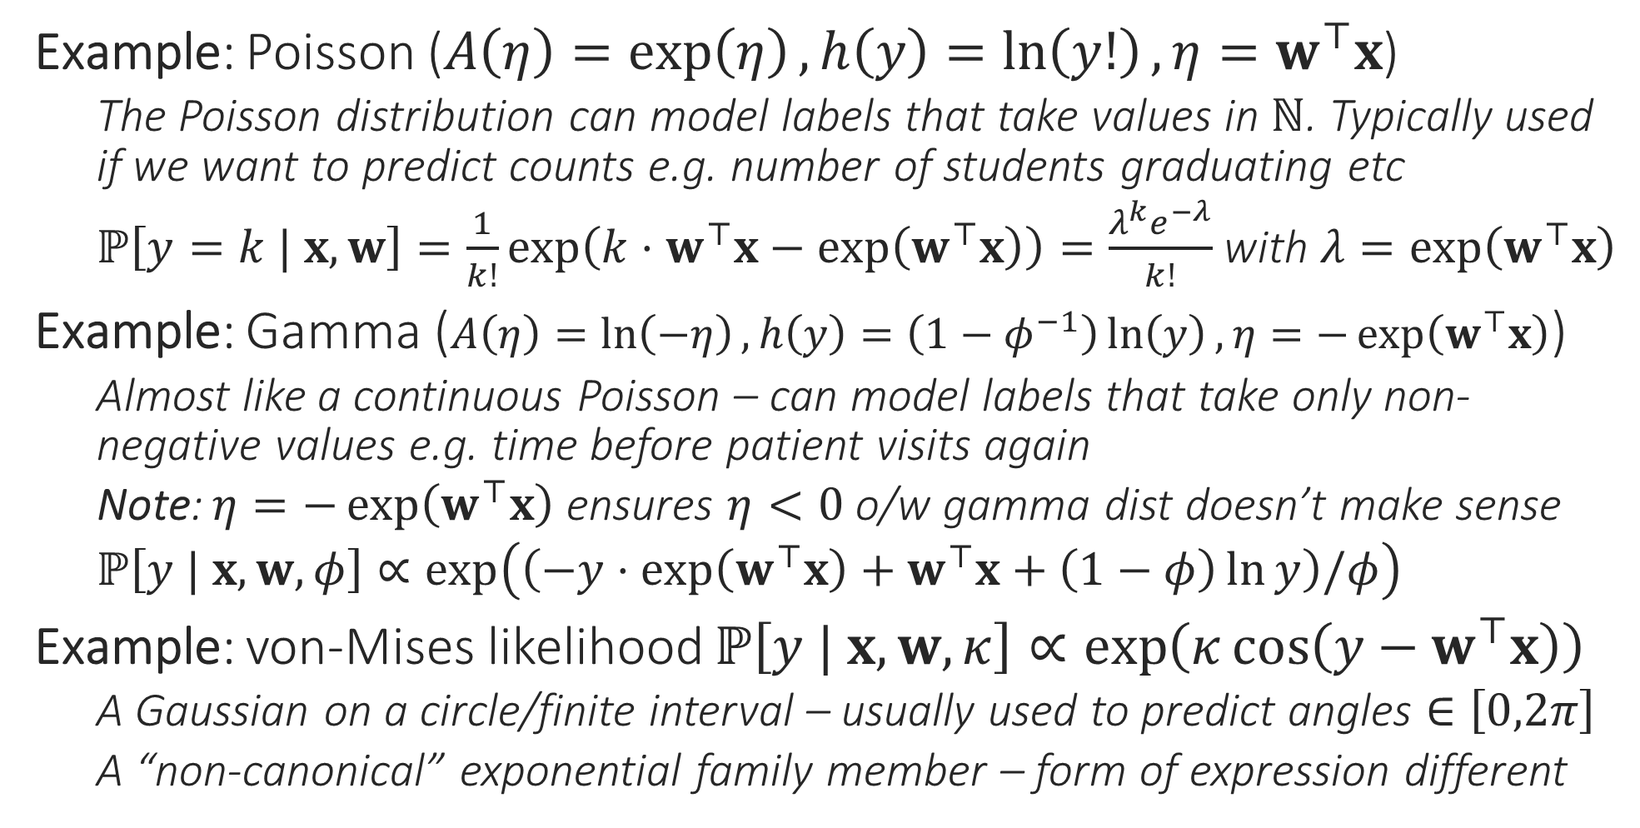
Generalized Linear Models
Example: Poisson ($A\left(η\right)=\exp\left(η\right),h\left(y\right)=\ln\left(y!\right),η=w^{⊤}x$)
The Poisson distribution can model labels that take values in $ℕ$. Typically used if we want to predict counts e.g. number of students graduating etc
$ℙ\left[y=k | x,w\right]=\frac{1}{k!}\exp\left(k⋅w^{⊤}x−\exp\left(w^{⊤}x\right)\right)=\frac{λ^{k}e^{−λ}}{k!}$ with $λ=\exp\left(w^{⊤}x\right)$
Example: Gamma ($A\left(η\right)=\ln\left(−η\right),h\left(y\right)=\left(1−φ^{−1}\right)\ln\left(y\right),η=−\exp\left(w^{⊤}x\right)$)
Almost like a continuous Poisson – can model labels that take only non-negative values e.g. time before patient visits again
Note: $η=−\exp\left(w^{⊤}x\right)$ ensures $η<0$ o/w gamma dist doesn’t make sense
$ℙ\left[y | x,w,φ\right]∝\exp\left(\left(−y⋅\exp\left(w^{⊤}x\right)+w^{⊤}x+\left(1−φ\right)\ln{y}\right)/φ\right)$
Example: von-Mises likelihood $ℙ\left[y | x,w,κ\right]∝\exp\left(κ\cos\left(y−w^{⊤}x\right)\right)$
A Gaussian on a circle/finite interval – usually used to predict angles $∈\left[0,2π\right]$
A “non-canonical” exponential family member – form of expression different

Slide 5
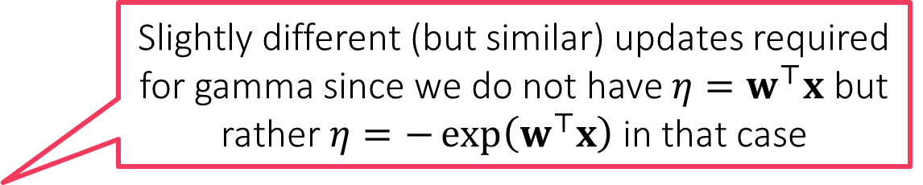
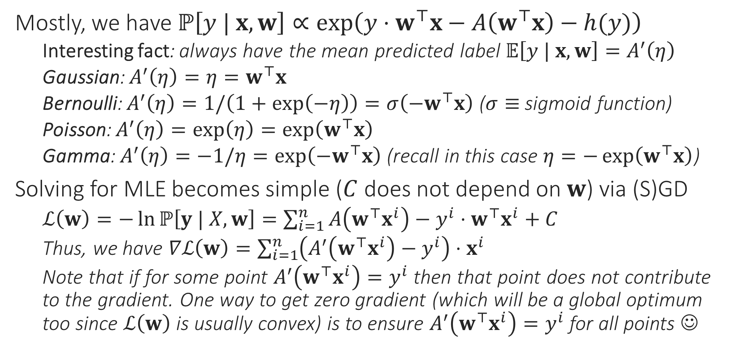
MLE with GLMs
Mostly, we have $ℙ\left[y | x,w\right]∝\exp\left(y⋅w^{⊤}x−A\left(w^{⊤}x\right)−h(y)\right)$
Interesting fact: always have the mean predicted label $𝔼\left[y | x,w\right]=A^{′}\left(η\right)$
Gaussian: $A^{′}\left(η\right)=η=w^{⊤}x$
Bernoulli: $A^{′}\left(η\right)=1/\left(1+\exp\left(−η\right)\right)=σ\left(−w^{⊤}x\right)$ ($σ≡$ sigmoid function)
Poisson: $A^{′}\left(η\right)=\exp\left(η\right)=\exp\left(w^{⊤}x\right)$
Gamma: $A^{′}\left(η\right)=−1/η=\exp\left(−w^{⊤}x\right)$ (recall in this case $η=−\exp\left(w^{⊤}x\right)$)
Solving for MLE becomes simple ($C$ does not depend on $w$) via (S)GD
$ℒ\left(w\right)=−\ln{ℙ\left[y | X,w\right]}=\sum_{i=1}^{n}{A\left(w^{⊤}x^{i}\right)−y^{i}⋅w^{⊤}x^{i}}+C$
Thus, we have $∇ℒ\left(w\right)=\sum_{i=1}^{n}{\left(A^{′}\left(w^{⊤}x^{i}\right)−y^{i}\right)⋅x^{i}}$
Note that if for some point $A^{′}\left(w^{⊤}x^{i}\right)=y^{i}$ then that point does not contribute to the gradient. One way to get zero gradient (which will be a global optimum too since $ℒ\left(w\right)$ is usually convex) is to ensure $A^{′}\left(w^{⊤}x^{i}\right)=y^{i}$ for all points ☺
Slightly different (but similar) updates required for gamma since we do not have $η=w^{⊤}x$ but rather $η=−\exp\left(w^{⊤}x\right)$ in that case

